Slide 1
MIS 432 – SPRING 2023
Brendan Gosa – bmg5777

Slide 2
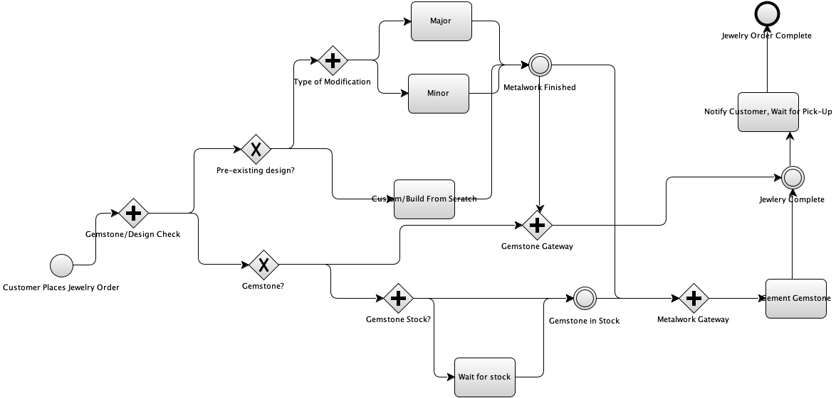
An image of your version of the BPMN diagram of the process.
6 days of labor ($612)
Completed with Yauqiang BPMN Editor
Average of $102 per day spent
All quantities of labor/cost are from average statistics
3 days of labor ($306)
2 days of wait ($204)
14 days of labor ($1428)
7 days of labor ($714)
7 days of wait ($714)

Slide 3
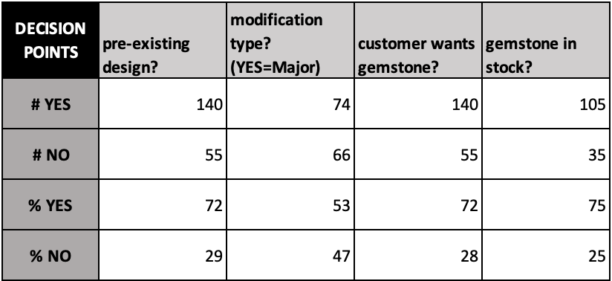
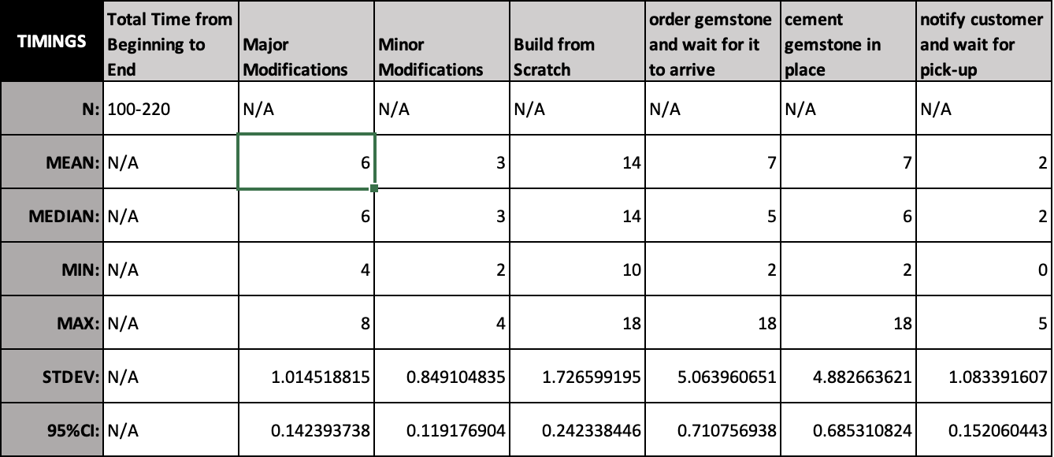
Statistics derived from your original dataset.

Slide 4
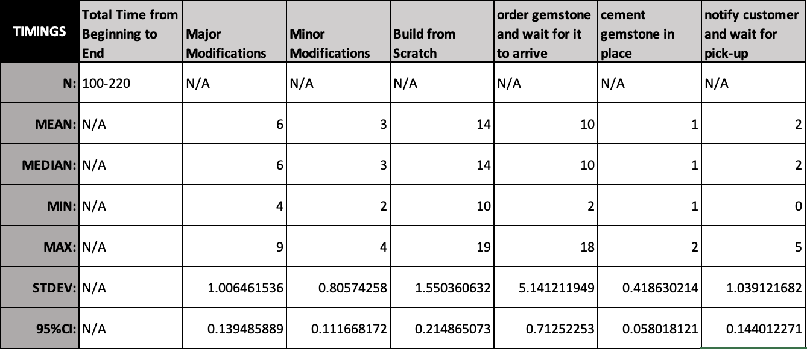
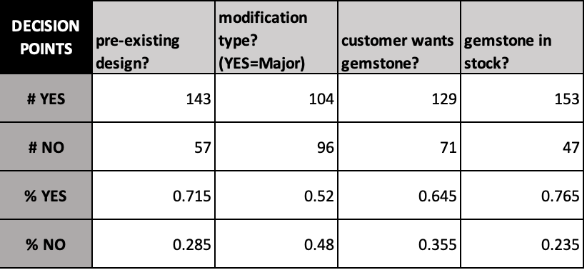
Statistics from the simulation and comparisons to the originals.
Original
Simulation

Slide 5
Statistics and decisions related to the questions asked below.
Question #1:
Custom pieces in my data only occur 29% of the time. Although they do take a significant amount of time (14 days), they aren’t frequent enough to make a significant difference.
After re-running the simulation total time was almost always around 2000-2200 days, as opposed to an original total of 2100-2300 days. An insignificant decrease especially compared to the results of question #2.
Question #2:
Around 72% of customers who order jewelry in my data, also wish to have a gemstone in place. But the chances of their gemstone being out of stock is only 25%. When this happens customers must wait on average 7 days for the gemstone order to come through.
After re-running the simulation total time always dipped below 2000 days, most seen around 1700-1800. As opposed to the original total, this decrease is a very significant change in time.

Slide 6
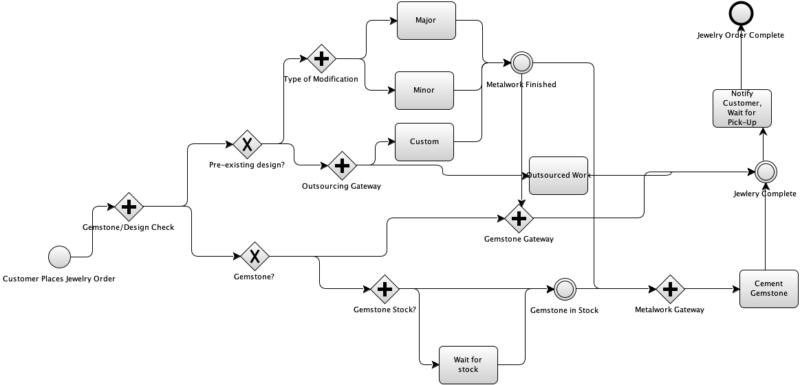
An image showing your alterations to the original BPMN diagram.
6 days of labor ($612)
New pathway has been circled in orange
Outsourcing gateway checks if the custom order requires a gemstone, if not it must be completed through original methods.
3 days of labor ($306)
14 days of labor ($1428)
2 days of wait ($204)
13 hours of labor ($1326)
7 days of labor ($714)
7 days of wait ($714)

Slide 7
Statistics and decision related to the structural change in the process.
As stated previously on slide 5, custom built jewelry pieces are a 29% occurrence. And only around 72% of these customers will also be requesting a gemstone to fulfill the outsourcing requirements. This 3rd party vendor would ultimately be helping with a very niche group of consumers (21%).
To make this implementation even less tempting, currently the average custom order is completed at around 14 days time. The 3rd party promises delivery in 12-14 days. This is far too comparable to our current speed of production. And the occasional speedy delivery under 12-14 days makes no difference when we can complete some custom orders in as fast as 10 days.
To confirm, the simulation was re-run and resulted in consistently similar values for the total days of labor. My recommendation would be to proceed as usual.

Slide 8
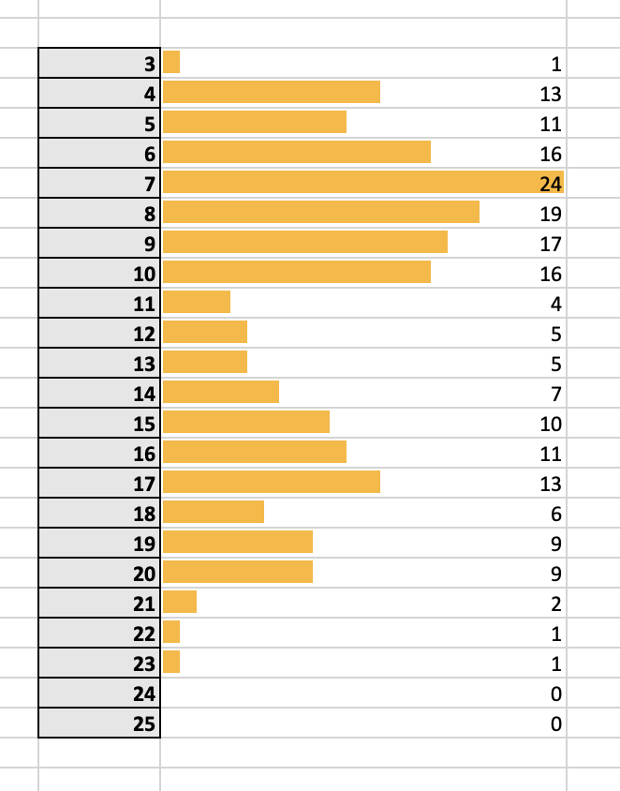
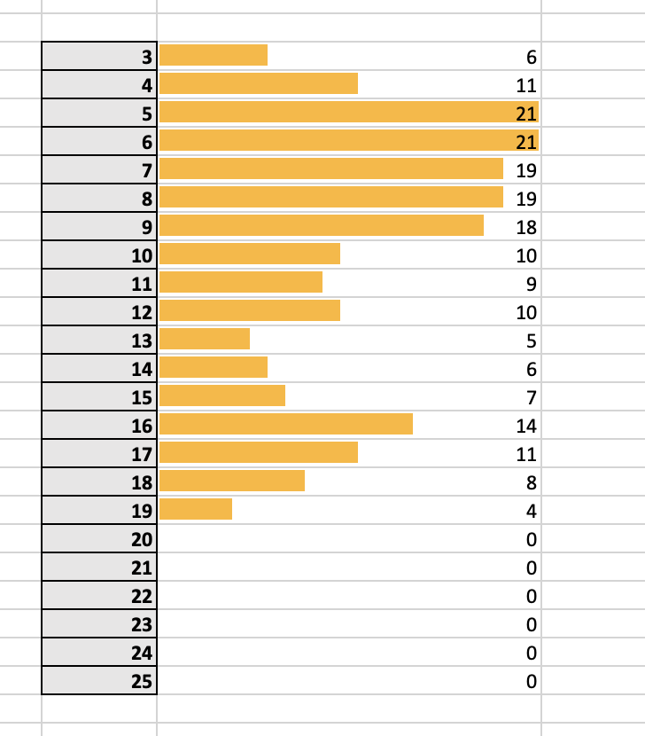
Any close-out materials.
Question #2 Histogram Changes
Before implanting changes, many orders occasionally took longer than 19 days. These outliers are extremely rare when simulating the revised changes. Rarely do any orders afterward reach beyond 19 days and a larger majority are finished in under 10 days.
Before
After

